Slide 1

Java for Beginners
Level 6b
Mr. Teasdale

Slide 2
Levels of Java coding
1: Syntax, laws, variables, output
2: Input, calculations, String manipulation
3: Selection (IF-ELSE)
4: Iteration/Loops (FOR/WHILE)
5: Complex algorithms
6: Arrays/Linked Lists
7: File management
8: Methods
9: Objects and classes
10: Graphical user interface elements

Slide 3
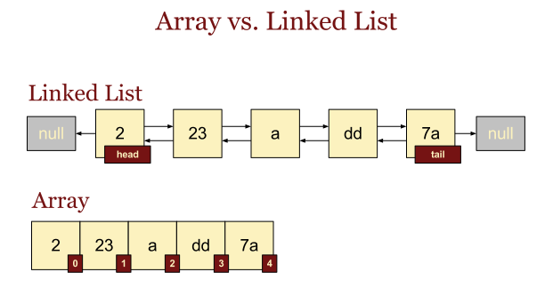
Arrays vs Linked Lists
Array
Fixed size
One or Two dimensions
List
Size can change
Only linear

Slide 4
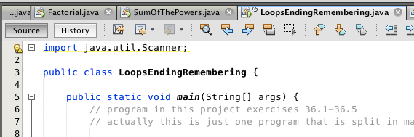
Before you using a Linked List…
Remember to import the utility libraries!
import java.util.*;

Slide 5
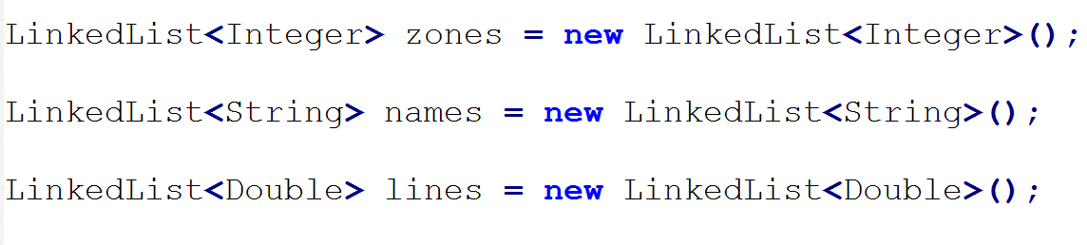
Creating a Linked List
Warning: don’t use double, int, char or boolean
Remember the () at the end!

Slide 6
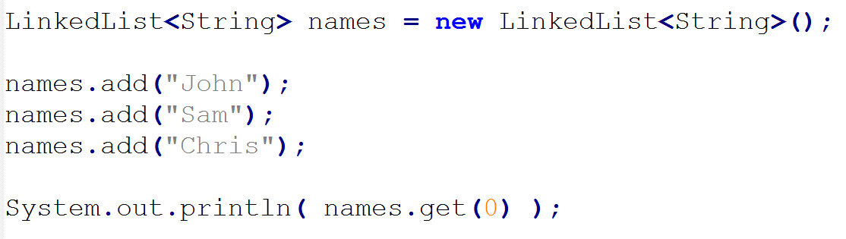
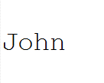
Adding items to a linked list
Output

Slide 7
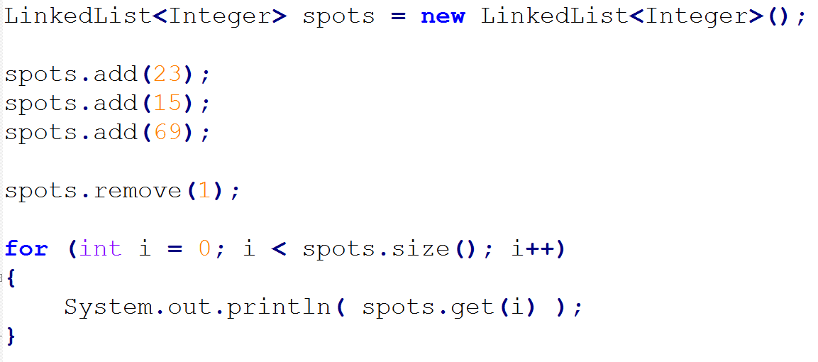

Removing items from a linked list
Output

Slide 8
Useful LinkedList methods
Method | What does it do
.add(xx) | Adds xx onto the end of the linked list
.remove(y) | Removes the element at position y
.size() | Returns how many elements there are in the linked list
.indexOf(xx) | Returns what element xx is stored in; returns -1 if element was not found

Slide 9
Beware getting the size!
.size() → Linked Lists
e.g. int k = zones.size(); //zones is a linked list
.length() → Strings
e.g. int m = name.length(); //name is a String
.length → arrays
e.g. int g = boxes.length; //boxes is an array

Slide 10
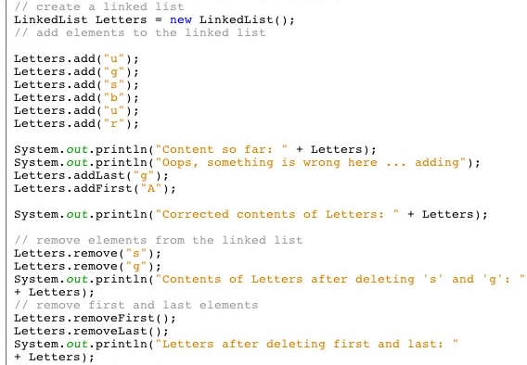
LinkedList example
What did the programmer forget to do…?

